Slide 1
US STATISTICS
SRIUDAYA DAMULURI

Slide 2
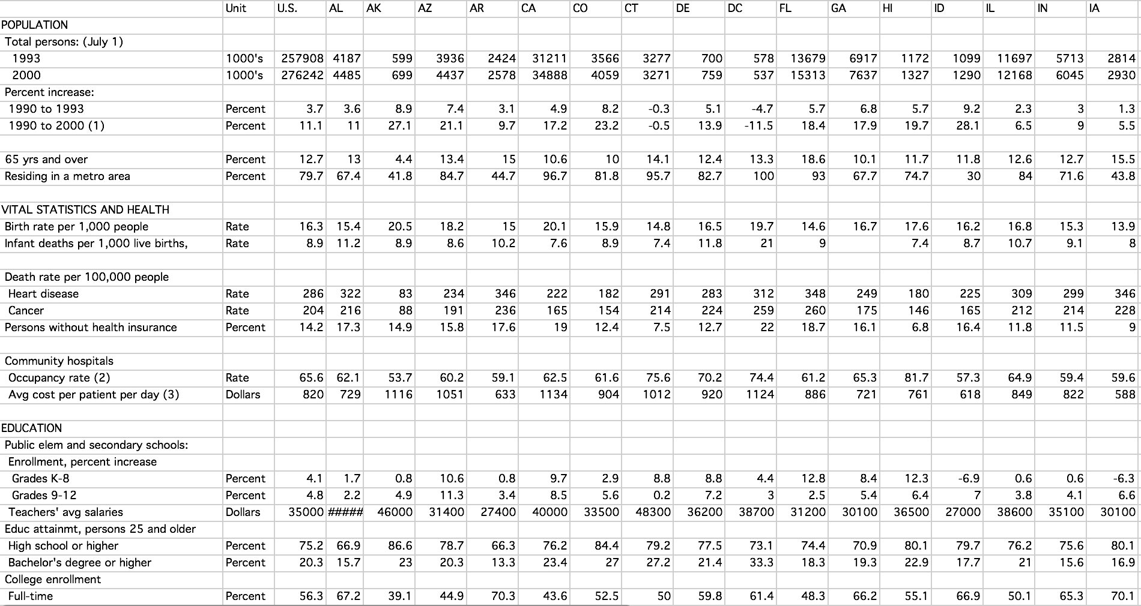
DATA SET BEFORE PRE-PROCESSING

Slide 3
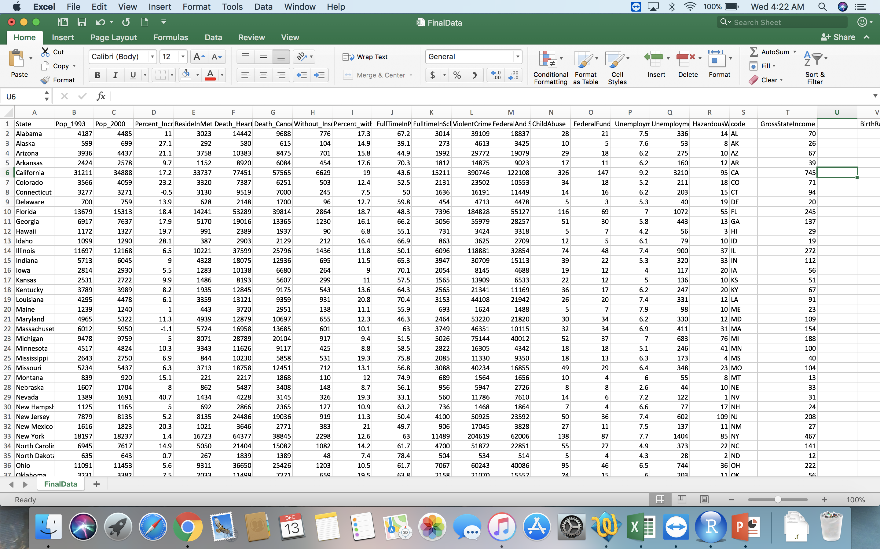
DATA SET FOR ANALYSIS

Slide 4
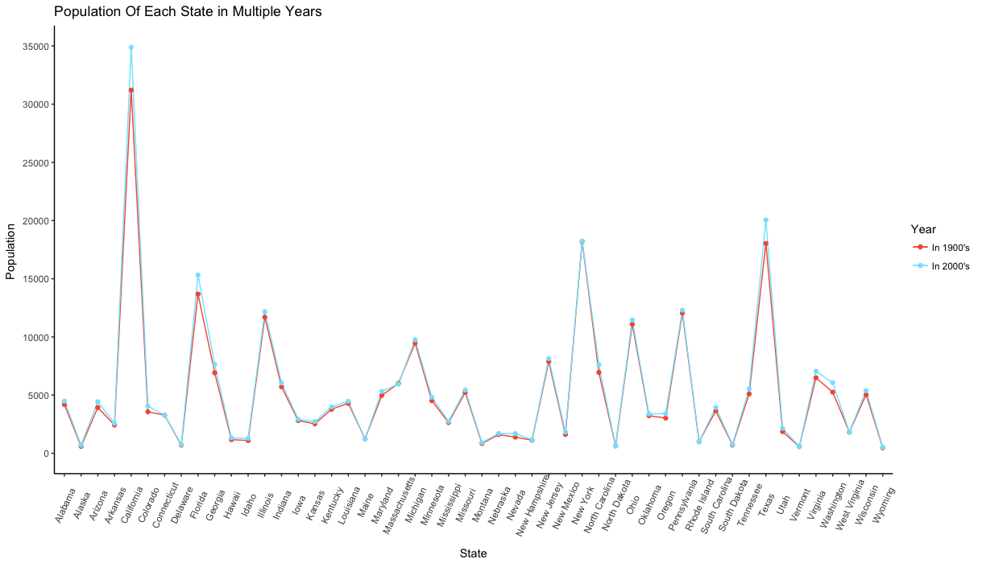
LINE GRAPH COMPARING POPULATION INCREASE IN EACH STATE(IN THOUDANDS

Slide 5
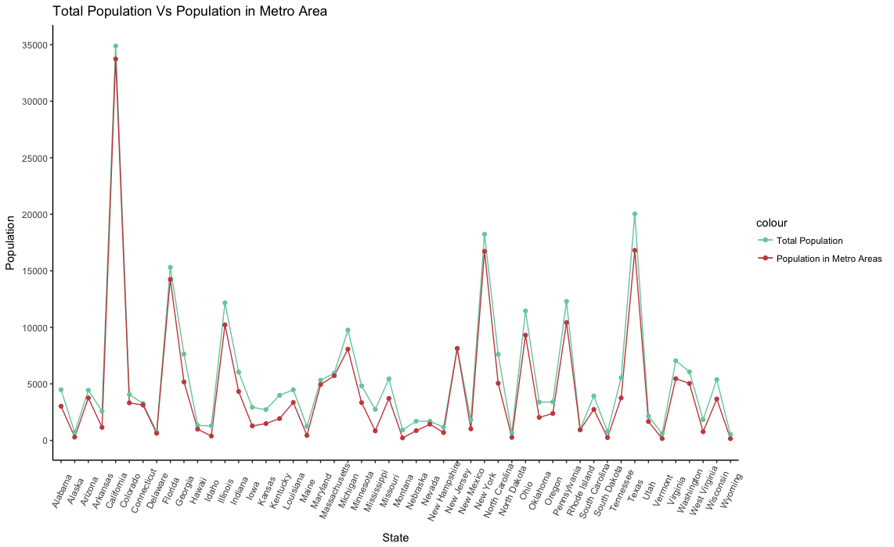
LINE GRAPH COMPARING THE POPULATION LIVING IN METRO AREAS(IN THOUSANDS)

Slide 6
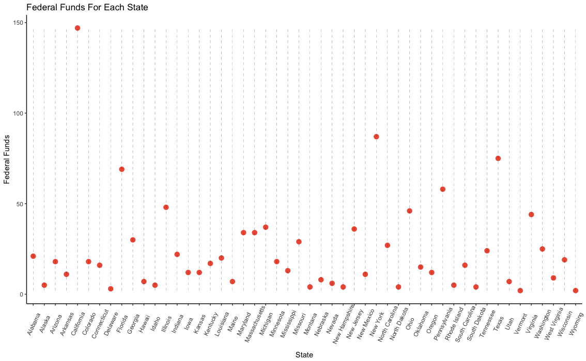
SCATTER PLOT

Slide 7
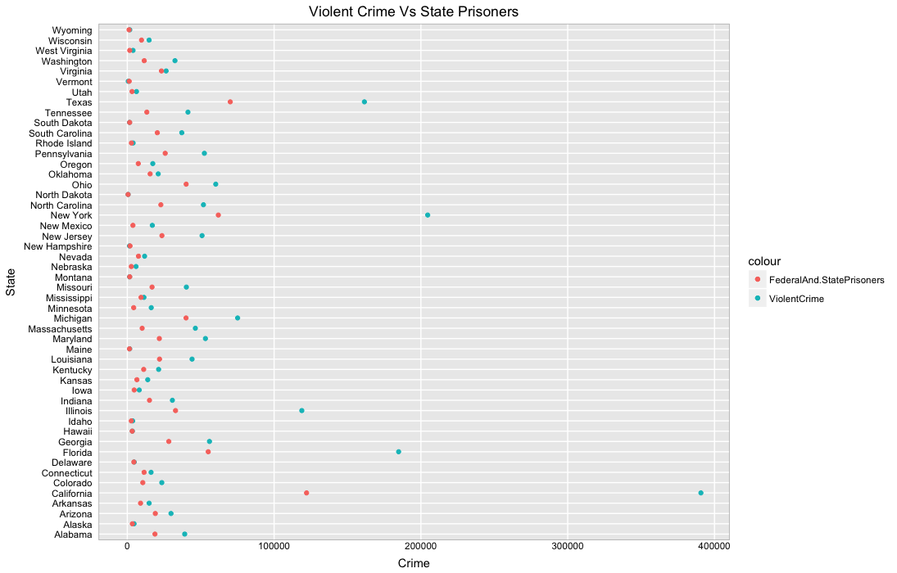
SCATTER PLOT

Slide 8
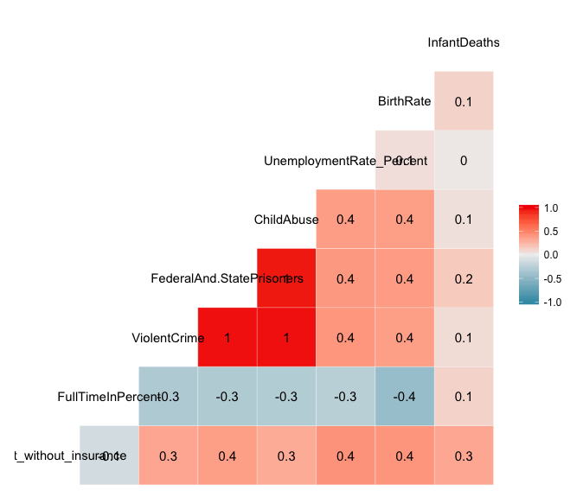
CORRELATION MATRIX

Slide 9
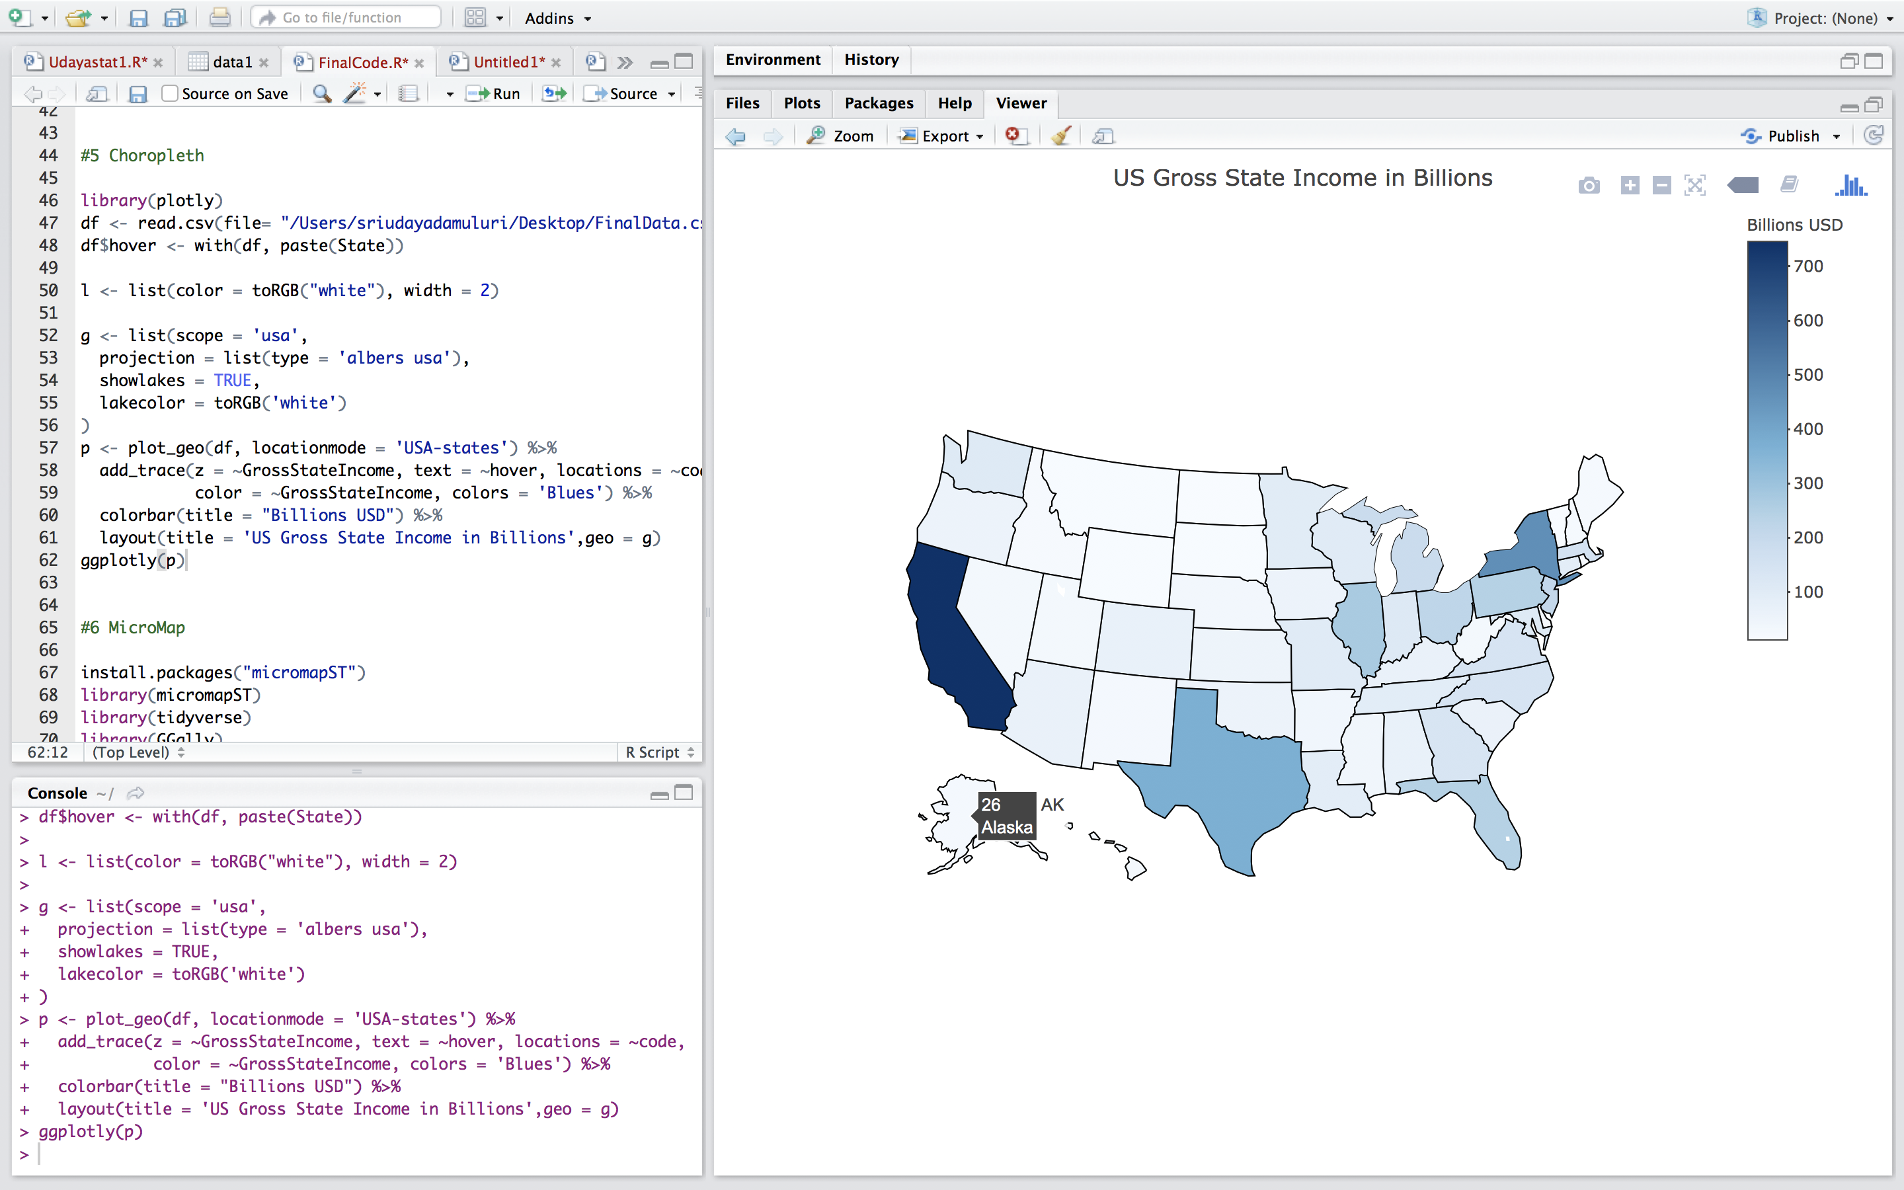
CHOROPLETH MAP

Slide 10
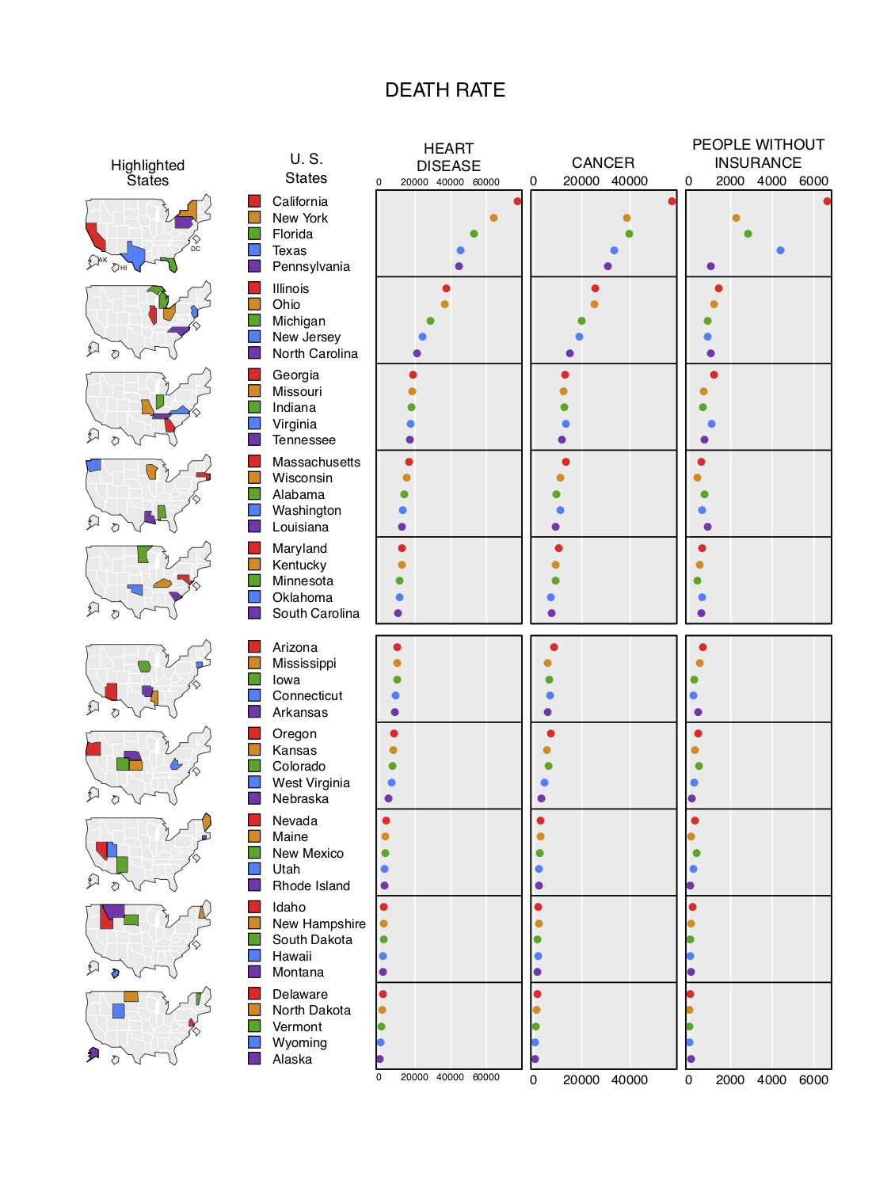
M
I
C
R
O
M
A
P

Slide 11
THANK YOU

